Slide 1

Wireless Communications
Project: OFDM Technology
Members: 12011104 岳翼遥
12012128 孙逸涵
12011923 张旭东
Date: 2022.12.14

Slide 2
CONTENTS
Introduction
01
孙
02
Theory
张
03
Basic task
岳
04
Advanced task
孙
05
Q&A

Slide 3

01
PART
Introduction

Slide 4
小标题
EE313: Wireless Communications
4

Slide 5
小标题
EE313: Wireless Communications
5

Slide 6
小标题
EE313: Wireless Communications
6

Slide 7
02
PART
Theory
EE313: Wireless Communications
7

Slide 8
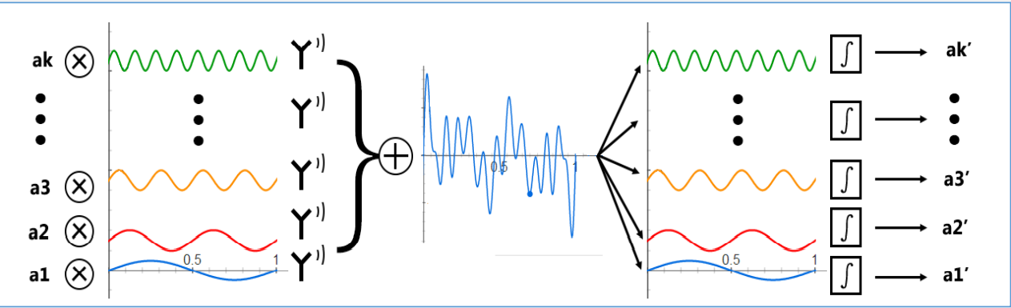
Basic idea of OFDM
Think of the modulation symbol as the spectrum of the signal
IFFT at the transmitter
FFT at the receiver
Parallel transmission mode
EE313: Wireless Communications
8

Slide 9

Basic idea of OFDM
Improve frequency band utilization rate
EE313: Wireless Communications
9

Slide 10
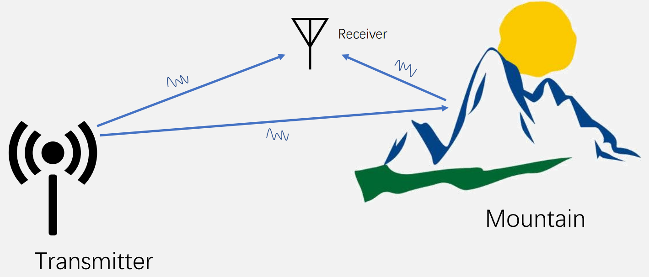
Multipath Propagation
EE313: Wireless Communications
10

Slide 11
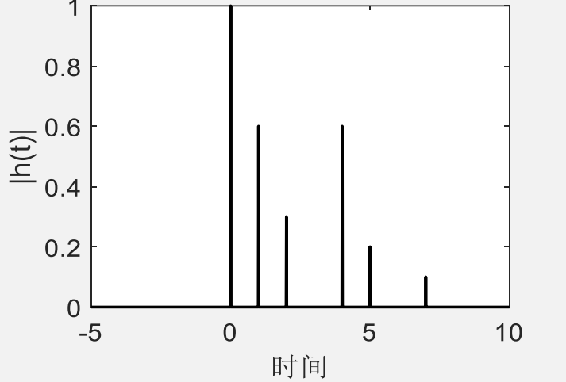
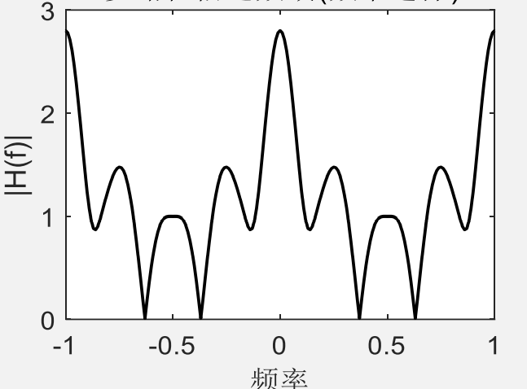
Multipath Propagation
Frequency selective fading
EE313: Wireless Communications
11

Slide 12
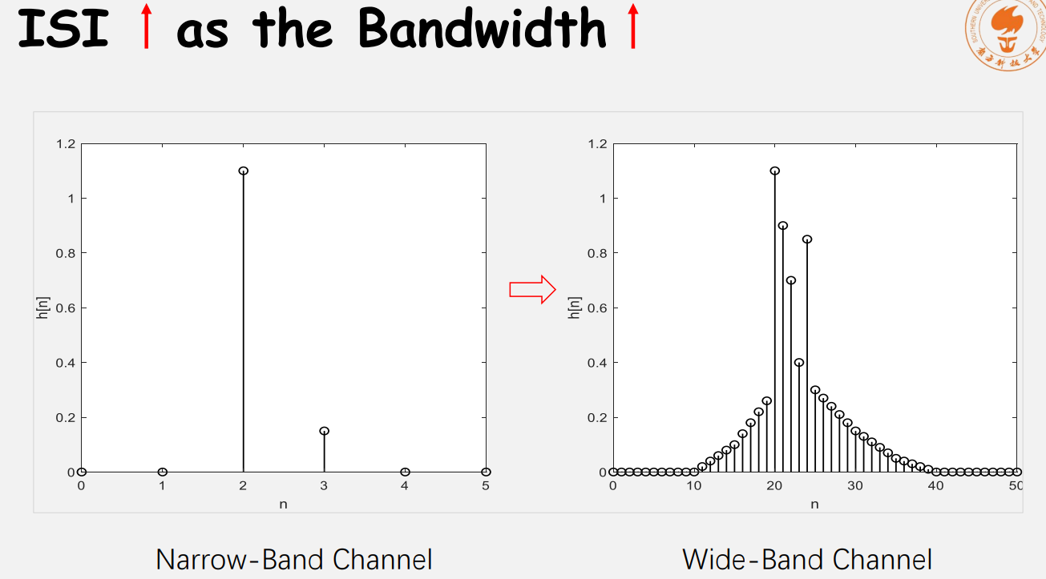
Multipath Propagation
EE313: Wireless Communications
12

Slide 13
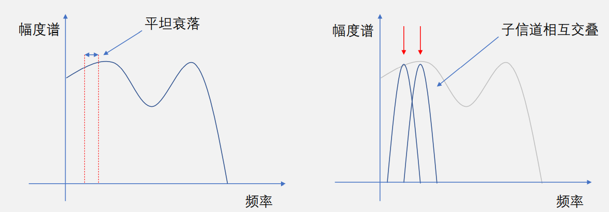
Multipath Propagation
Subchannel flat fading
subchannel overlap
Sample at zero crossing
EE313: Wireless Communications
13

Slide 14
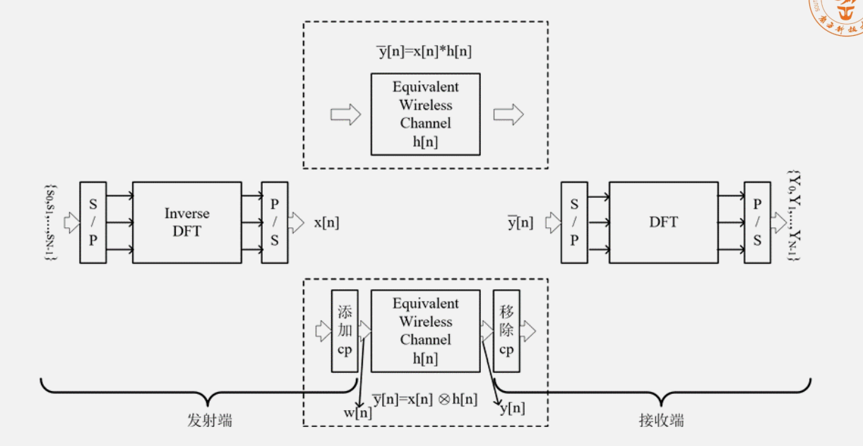
Adding Cycle Prefix
EE313: Wireless Communications
14

Slide 15
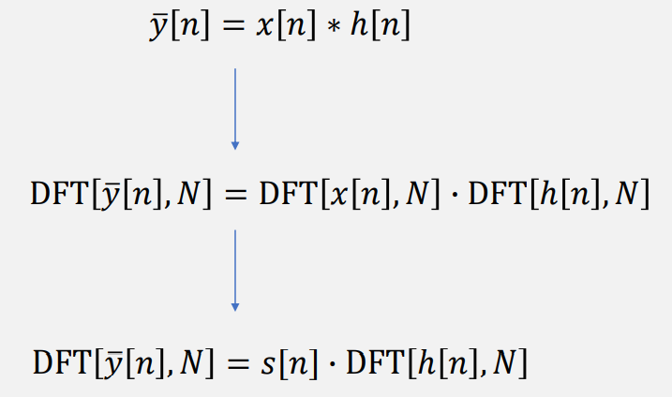
Adding cycle prefix
N≥length(x[n])+length(h[n])-1
EE313: Wireless Communications
15

Slide 16
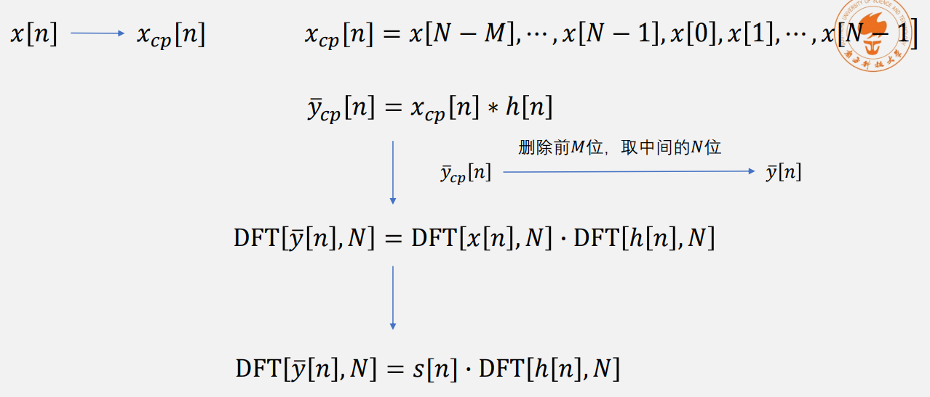
Adding Cycle Prefix
M＞Delay extension of multipath propagation
EE313: Wireless Communications
16

Slide 17
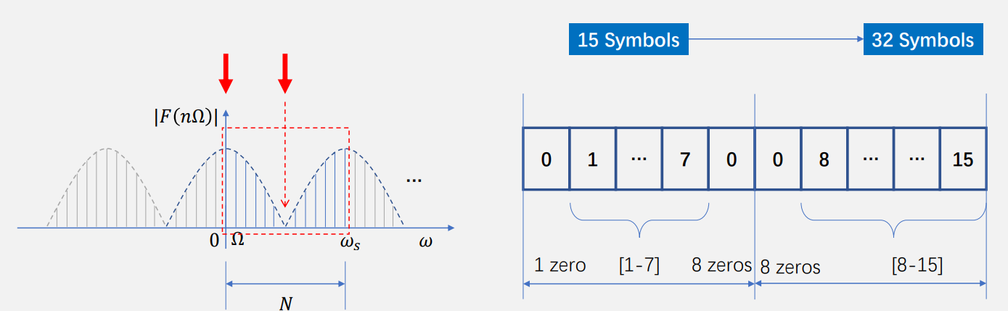
Insert None Tone
1. Insert 0 into the high-frequency component, which can avoid the transmission of high-frequency components.
2. Place the sequence at low frequency,easy to increase the length of the original sequence
EE313: Wireless Communications
17

Slide 18
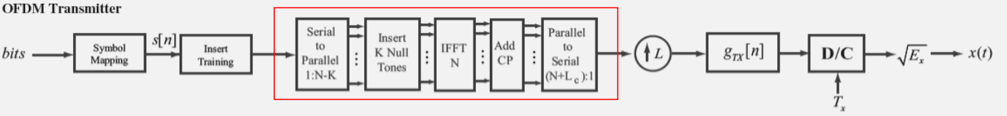
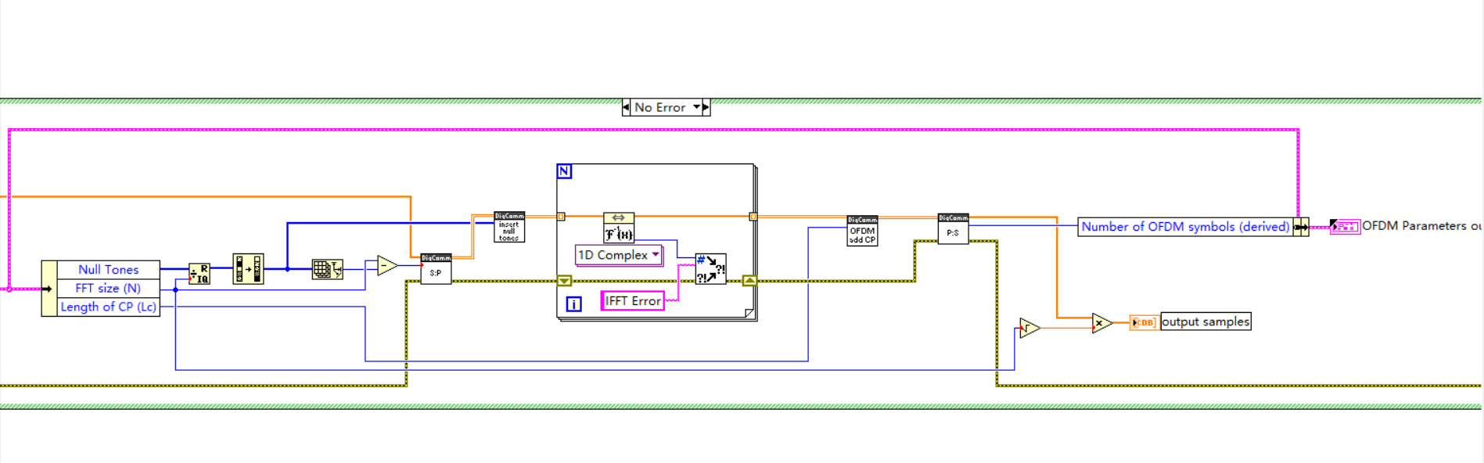
OFDM Transmitter
EE313: Wireless Communications
18

Slide 19
OFDM Transmitter
1、convert serial input stream to parallel stream, size =N-K
2、insert K null tones， size=N
3、perform N IFFT
4、add cycle prefix
5、convert parallel stream to serial stream, size=N+Lc
EE313: Wireless Communications
19

Slide 20
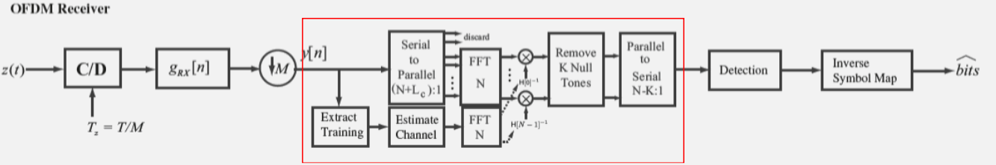
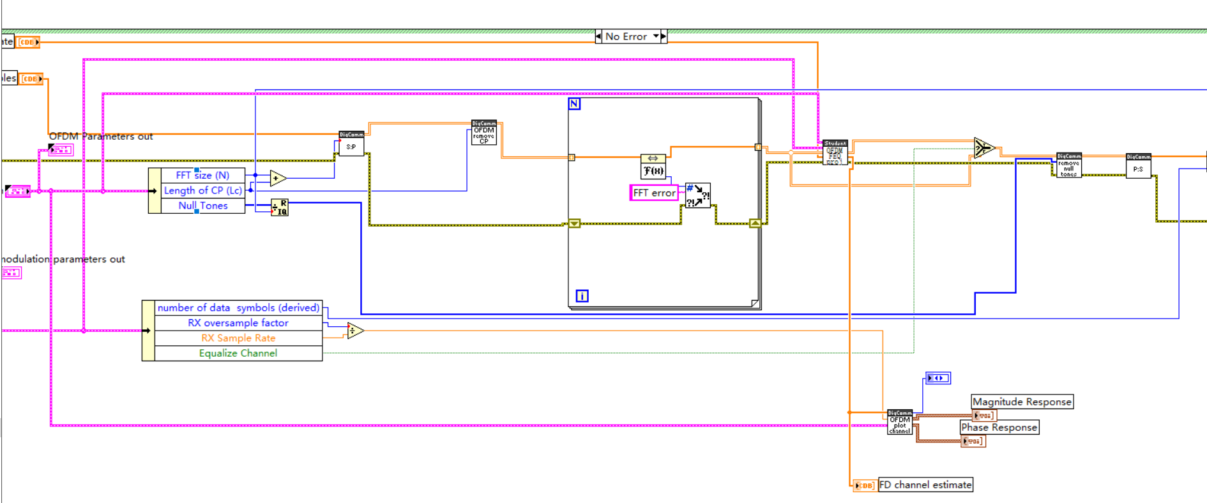
OFDM Receiver
EE313: Wireless Communications
20

Slide 21
OFDM Receiver
1、convert serial input stream to parallel stream, size = N+Lc
2、remove cycle prefix， size=N
3、perform N FFT
4、apply frequency domain equalizier
5、remove null tones，size =N-k
6、 convert parallel stream to serial stream
EE313: Wireless Communications
21

Slide 22
03
PART
Basic task

Slide 23
小标题
EE313: Wireless Communications
23

Slide 24
小标题
EE313: Wireless Communications
24

Slide 25
04
PART
Advanced task

Slide 26
小标题
EE313: Wireless Communications
26

Slide 27
小标题
EE313: Wireless Communications
27

Slide 28
THANKS

Slide 29
Q&A

